Slide 1
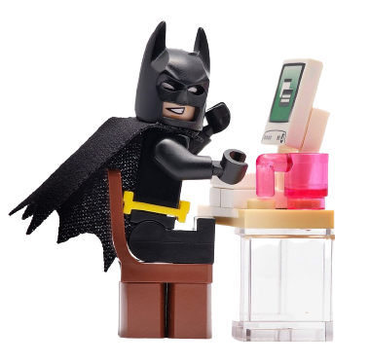
Bring Your Child to Work Day
Welcome!
Bijay Kuwar
Carolyn Brehm
Kishore Gadiraju
April 27, 2023

Slide 2


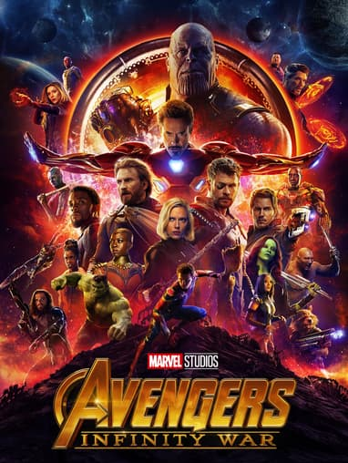

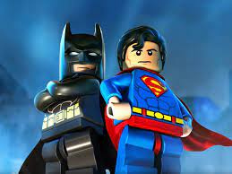
Let’s welcome each other
What is your Name?
What is your most wanted Superpower?

Slide 3
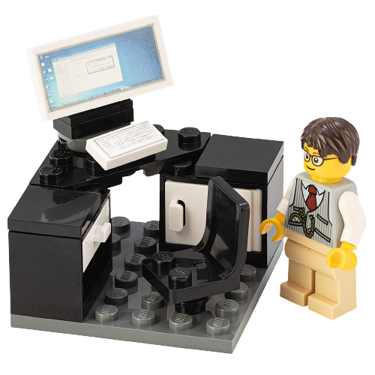
Agenda
Introduction to Programming
Python Tutorials
Project

Slide 4

What is Programming?
Programming is the process of creating a set of instructions to tell a computer how to perform a task in steps
Programming can be done using a variety of computer languages like Java, C, HTML, Python, etc.
The most popular computer language is Python, and it is used by many companies including NASA , Google, Amazon etc.
Why is it popular? It's easy to learn, very powerful and flexible
Python can be used to build games, applications, websites or to explore data
Notes:
Your phone, car, fridge, what else can you think about?
Algorithm: R, MATLAB, Python,
C++, Java
Database: SQL
Web: html and JavaScripts
And many many more!
Did any one already learning this superpower to talk to the computers?
Python is one of the easiest languages to learn and use, while at the same time being very powerful: It is one of the most used languages by highly productive professional programmers. Also Python is a free language! If you have your own computer, you can download it from the Internet....

Slide 5
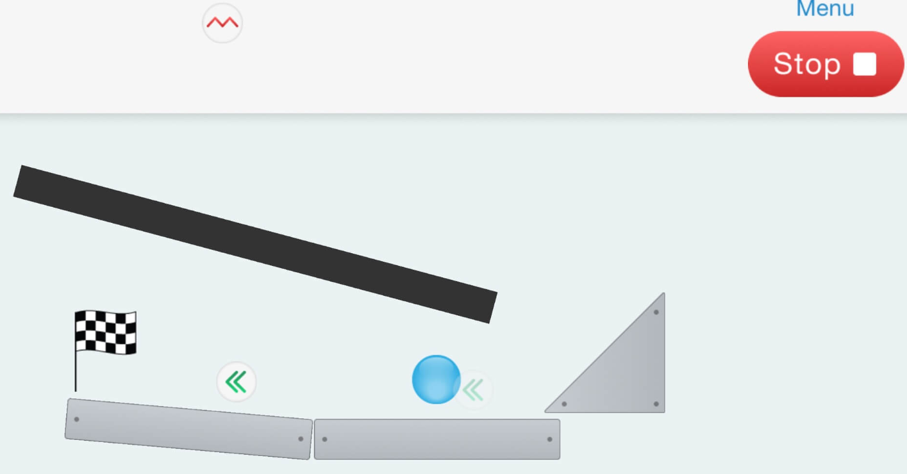
Why Should You Learn Programming?
It helps to build your problem-solving and critical thinking skills.
Have you played the Bubble Ball game?
Robert Nay developed the Bubble Ball game when he was in the 8th grade and just 14-years-old!
In the first two weeks, it was downloaded two million times from iTunes, and he made $2 million from it.
Once you become an expert programmer, you can build your own games or websites, and share it with your friends. Isn’t that cool?
Notes:
Your phone, car, fridge, what else can you think about?
Algorithm: R, MATLAB, Python,
C++, Java
Database: SQL
Web: html and JavaScripts
And many many more!
Did any one already learning this superpower to talk to the computers?
Python is one of the easiest languages to learn and use, while at the same time being very powerful: It is one of the most used languages by highly productive professional programmers. Also Python is a free language! If you have your own computer, you can download it from the Internet....

Slide 6

What do your parents do with programming at BMS?
Drug Discovery
Clinical Trial Study
Marketing and Sales
And many many more!

Slide 7

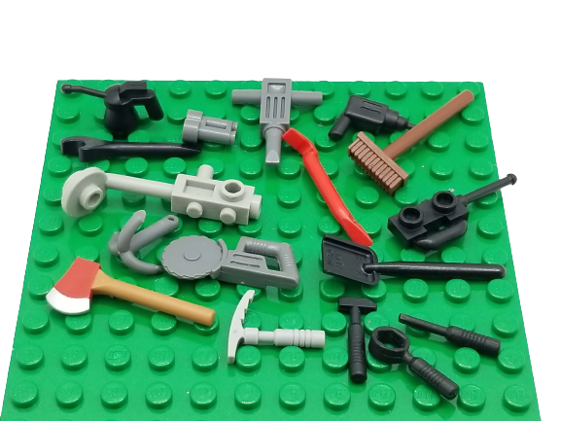
Get ready
Log in to your laptop
Open the HandoutNotes on your desktop
Open a new window

Slide 8
Python Compiler
What does a compiler do?
Compiler is a special program that translates your program into a machine code which the machine understands
Most computers come with basic Python compiler. To execute the Python program, you have to first save the code in a file with .py extension, and then run the following in the command line:
C:\<your folder>\python helloworld.py
However today we will be using an online compiler and execute a Python program directly in a web browser
https://www.programiz.com/python-programming/online-compiler/

Slide 9

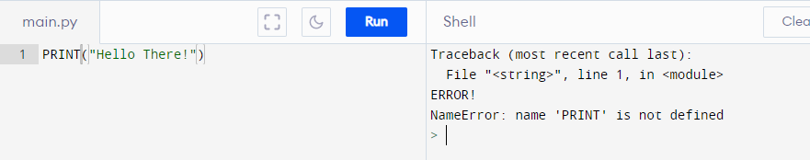
Python Syntax
What is a Syntax?
It’s a set of commands you need to remember and rules to follow while writing your program. If you don’t follow these rules, then the program will error out and not work.
Few Basis Syntax Rules:
All commands are case-sensitive
Code should be indented (very important. Indentation refers to spaces on the beginning of the line)
Use # symbol to add comments in your code (compiler will ignore commands if # is present in the beginning of the line)
For example, the command to display something in Python is:
print(“Hello There!”)
Note the command print is in lower case. If you accidently use upper case, the compiler will not understand the command, and it will throw an error.
PRINT(“Hello There!”)

Slide 10

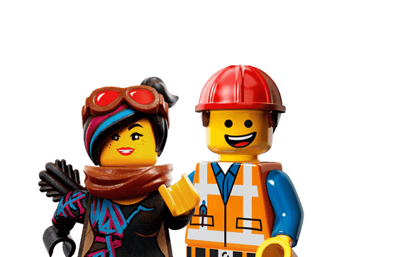
My First Python Program (Code 1)

Slide 11
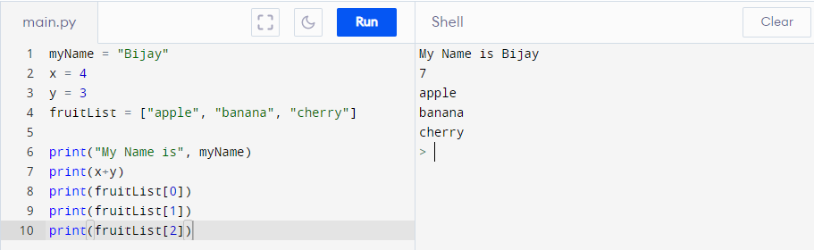
Python Variables (Code 2)
Variables are used to store data

Slide 12
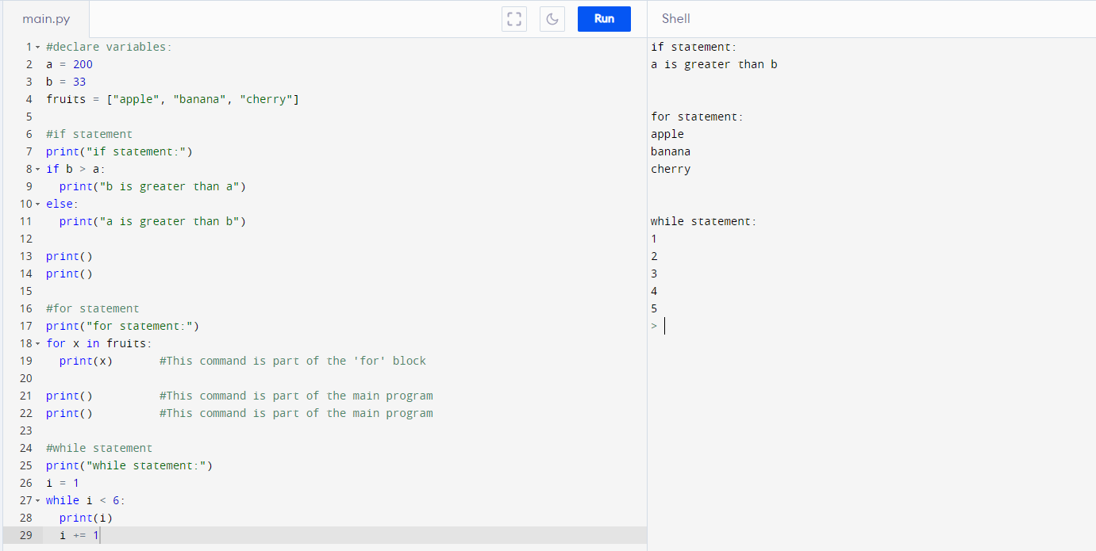
Python Conditions and Loops (Code 3)

Slide 13
Python Functions
A function is a block of reusable code. It only runs when it is called.
You can pass data, known as parameters, into a function.
Let’s write a Python code for this to understand functions!
How do you put an elephant into a fridge?
open the fridge
clear the fridge
put in the elephant
and close the door
How do you put an ostrich into a fridge?
open the fridge
clear the fridge
put in the ostrich
and close the door

Slide 14

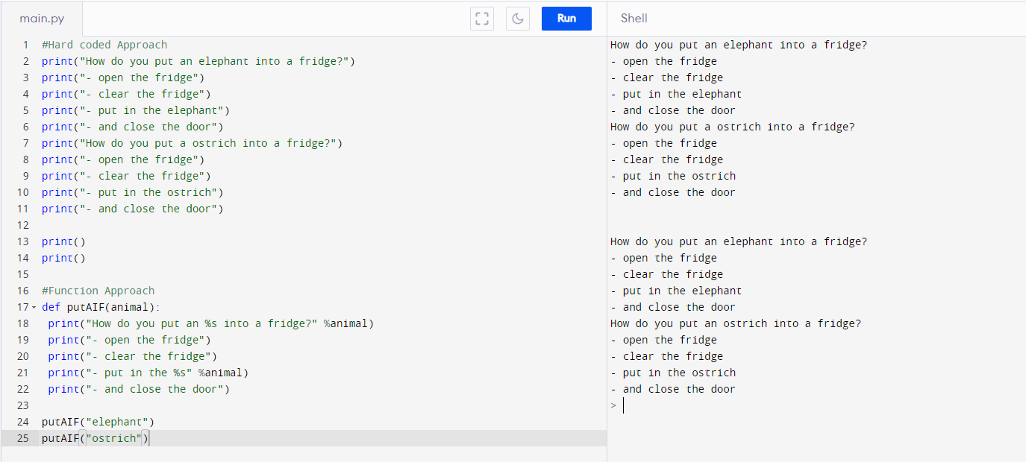
Python Functions (code 4)

Slide 15
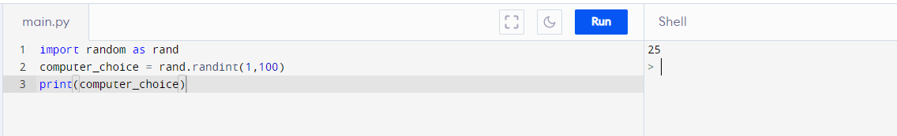
Python Library
Library is a reusable code that you may want to include in your program.
Think of it like functions created by someone else so that you don’t have to code it.
You need to import the library into your program before you can use it.
Notes:
some 72,000 of them in the Python Package Index (PyPI) and still growing constantly

Slide 16
Python Library (code 5)
Notes:
some 72,000 of them in the Python Package Index (PyPI) and still growing constantly

Slide 17

Project 1: Rock, Paper, Scissors Game
In this exercise, we will build the rock, paper, scissors game and compete against the computer!
Algorithm:
Generate a random number between 1 & 3
Ask user to provide a number (rock =1, scissors = 2, paper = 3)
Compare the two numbers and display output
Check if the user wants to continue

Slide 18
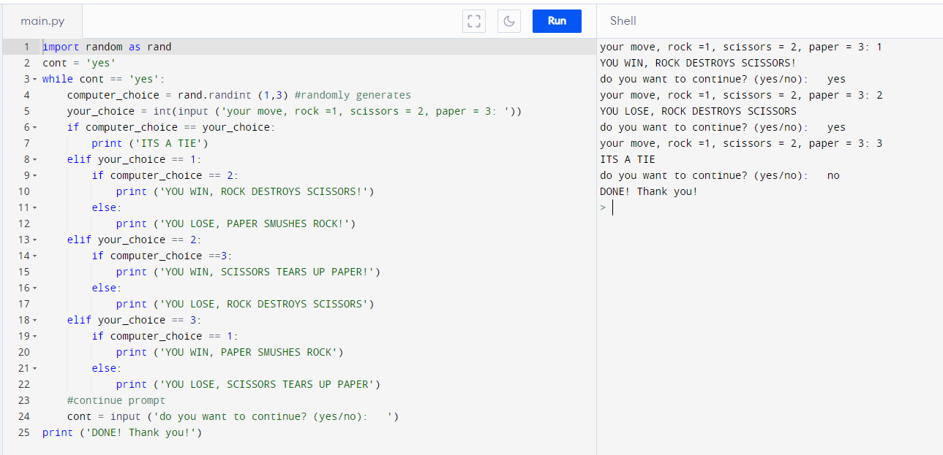
Project 1: Rock, Paper, Scissors Game (code 6)

Slide 19
Project 2: Password Strength Checker
In this exercise, we will check whether your password is strong enough.
We will use the string module from the Python standard library
Algorithm:
Ask user if they want to check their password strength
Get the password
Count the number of letters, numbers, whitespaces and special characters
Generate a score
Display the results

Slide 20

Congratulations Young BMS Programmers

Slide 21
Additional Slides

Slide 22
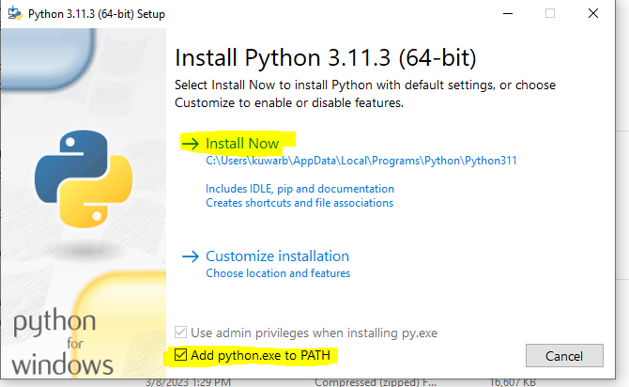
Install Python on your Computer
Go to https://www.python.org/downloads/
Click on the download button
After download is complete, click on the executable to start the installation
Click on checkbox “Add python to PATH” (see image)
Click on Install Now

Slide 23
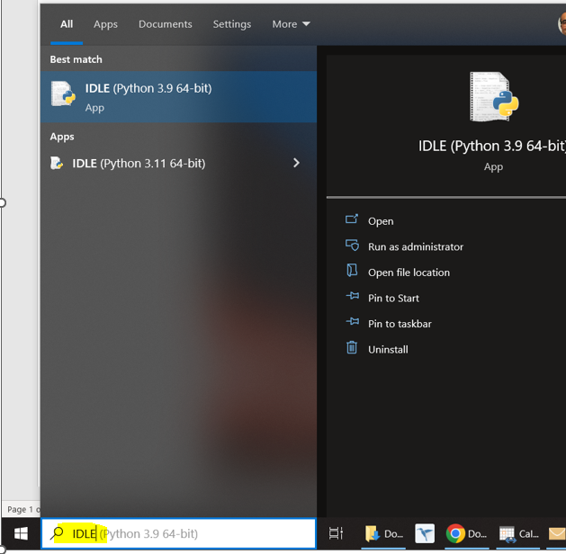
Python IDLE (Integrated Development and Learning Environment
Python IDLE is installed along with the Python compiler
IDLE provides a file editor functionality where python programs can be written
You can execute Python commands directly on IDLE

Slide 24
Create a Python program on your computer
Search and launch IDLE program on your computer
From menu, select File > New File
Type print("Hello World!") in the file
From menu, select Run > Run Module
The output will be displayed in the IDLE window
That’s it!! Save the file on your computer so that you can continue working on it later.

